Slide 1
HL7 Da Vinci Training
February ??, 2025
Coverage Requirements Discovery (CRD) Deep Dive
2025 HL7 Da Vinci Burden Reduction and Payor API Implementer Support
®Health Level Seven and HL7 are registered trademarks of Health Level Seven International, registered with the United States Patent and Trademark Office.

Slide 2

Who am I?
Name: Lloyd McKenzie
Company: Dogwood Health
Background:
One of FHIR’s 3 initial editors
Co-chair FHIR-Infrastructure, past chair FHIR Management Group, FMG member
HL7 Fellow
Technical lead for CRD IG
Da Vinci Deputy Technical Director
lloyd@dogwoodhealthconsulting.com

Slide 3
This presentation
Is part of a set of introductory training materials for the April 2025 Da Vinci Education Event
Can be downloaded here:
https://github.com/FHIR/documents/tree/master/presentations/2025-04-DaVinci
Is licensed for use under the Creative Commons, specifically:
Creative Commons Attribution 3.0 Unported License
(Do with it as you wish, so long as you give credit

Slide 4

Pre-requisites & Post-requisites
Before taking this course, you should take:
Introduction to FHIR
How to read a FHIR IG
USCDI/US Core
SMART on FHIR & CDS Hooks
Da Vinci Healthcare Record Exchange (HRex)
This course is a prerequisite to
Documentation and Templates Rules (DTR)

Slide 5

Course Objectives
After completing this course, you should be able to:
Explain the relationship between CRD and CDS Hooks
List the mandatory and optional hook types used by CRD
Describe how CRD relates to DTR and PAS
Fill out the coverage-information extension

Slide 6
Outline

Slide 7
What is CRD?
Coverage Requirements Discovery
Decision support tool for providers
“What does the payer know that can help me right now?”
Called as part of clinical workflow
Required to provide information about coverage
MAY provide other types of information

Slide 8
Primary objectives of CRD
Coverage information affects provider decisions
Is this intervention covered?
If not, intervention may not be workable for patient
Is prior authorization needed?
If so, may impact service timing, which may make a different therapy a better choice
Do I need to collect any data from the patient to support authorization/claims?
If so, better to do it now
CRD strives to have answers to these questions at the time the provider is
Writing orders, booking appointments, admitting the patient

Slide 9
A pleasant side effect
In some cases, a payer may determine:
Yes, this service is covered
The service requires prior authorization
All information needed for an authorization is available in the record
Authorization requirements are met
CRD allows an authorization number to be provided even though no authorization was formally sought

Slide 10
What CRD is not
Not a formal substitute for prior authorization
Needed data may be unavailable
CRD cannot refuse authorization
Not a tool for back-office staff
They might use CRD, but not targeted at them
Not a data collection tool
Data is held only for audit purposes

Slide 11
How CRD is different
Data coming to payer will be clinical
SNOMED, text, etc.
Actual billing codes could vary from what’s submitted
Data may be incomplete
May be missing date of service, performer/location, indication, etc.
No dollar amounts are specified
Payer response must be real-time

Slide 12
CRD Hooks

Slide 13
Supported CRD Hooks
order-select*
order-sign
order-dispatch
appointment-book
encounter-start*
encounter-discharge
Notes:
You can support others, but that’s outside CRD’s scope
Bold = must support
* = useful for caching
Not all hooks will exist
This is the typical order

Slide 14
Order-related hooks
All the order hooks (select, sign, & dispatch) support:
CommunicationRequest – Request for information transfer
DeviceRequest – Durable medical equipment and other devices
MedicationRequest – Drug orders and prescriptions
Only used where NCPDP doesn’t already cover the use-case
NutritionOrder – Food supplements, tube feeding
ServiceRequest – Lab, DI, referrals, anything not covered elsewhere
VisionPrescription – Glasses & contacts
EHRs only need to support orders their system produces
Notes:
Drill into each of the profiles and look at an example

Slide 15
Order collections
All the order hooks can pass in multiple orders
What orders can go together is driven by provider workflow
Multiple drugs in a prescription
Multiple lab tests in a requisition
Order that combines medications, devices, and referrals, etc.
Combination is not impacted by how things might be billed later
It’s not even a given that the orders will be filled at the same time by the same provider

Slide 16
Order Select
Status: Optional
Recommended at minimum to support caching
Payload:
patientId, encounterId, draftOrders
Allows early intervention in order cycle
E.g. “Not covered, but here’s a covered alternative” as soon as product selected
Could fire multiple times as order is edited
Should never trigger unsolicited prior auth
Never return a coverage-information that says more info needed

Slide 17
Order Sign
Status: Required
Payload:
patientId, encounterId, draftOrders
Fires only when orders are all done and ready to print/sign
Ok to send unsolicited auth at this stage
Must return a coverage-information response
Even if it says more information needed

Slide 18
Order Dispatch
Status: Required
Payload:
patientId, encounterId, draftOrders
Fires if client performs a dispatching process asking a specific performer to fulfill an undirected order
Only relevant if the initial response indicated “information needed” of either performer or location
Must return a coverage-information response
Even if it says more information needed

Slide 19
Appointment Book
Status: Required
Payload:
patientId, encounterId, appointments (with order or without)
Must return a coverage-information response
Even if it says more information needed
Fires when an appointment is scheduled.
Useful when booking appointments
with no order or order having no coverage-information
where coverage-information indicated more information was needed

Slide 20
Encounter Start
Status: Optional
Recommended at minimum to support caching
Payload:
patientId, encounterId
In addition to caching information, can return coverage-information based on the encounter service-type
Can also identify data to capture or activities to perform to close gaps

Slide 21
Encounter Discharge
Status: Optional
Payload:
patientId, encounterId
Will not return coverage-information
Primarily to allow review of discharge plan and ensure necessary documentation has been captured to support eventual claims

Slide 22
CRD Response Types

Slide 23
What is a ‘Response Type’?
CDS Hooks services can respond in two ways:
Cards: Content displayed to users, possibly with the ability for them to take action
System actions: Automated updates to records in the CDS Hook client system
Finite set of elements that can appear on either of those
CRD defines profiles for common kinds of responses that are relevant for payers to provide
Helps ensure consistency and interoperability
Theoretically possible for payers to provide other types of responses
These are outside the scope of CRD

Slide 24
Generic response rules
Cards
uuid mandatory
indicator (info/warning/critical) are from provider’s perspective
source.label must be patient/provider-friendly name for payer
source.topic is mandatory and draws from CRD card types
summary should be actionable
detail should put highest priority information first. If there are links, repeat them in links.url
links.url should point to location in page, not start of document
No expectation to support overrideReason
davinci-crd.associated-resource extension is mandatory

Slide 25
Generic response rules (cont’d)
Keep the number of cards manageable
Most important ones first
System action information should not be replicated in cards
Example

Slide 26
Response Type Overview
CRD defines 8 types of possible responses:
External Reference
Instructions
Coverage Information
Propose Alternate Request
Identify Additional Orders
Request Form Completion
Create or Update Coverage Records
Launch SMART Application

Slide 27
External Reference
Returns: Card
Must be supported by CRD clients and servers
Must have 1..* card.links with link.type of ‘absolute’
Allows payer to link to relevant clinical guidelines, prior auth requirements, printable forms, registries of in-network providers, etc.
summary & detail provide information on what the links are for
detail will typically not be needed.
Example

Slide 28
External Reference Example
TODO

Slide 29
Instructions
Returns: Card
Must be supported by CRD clients and servers
Must have summary and will typically have detail
Could contain any sort of decision support
Clinical reminders
Notifications of potential duplicate therapies or contraindications
Warning about deviation from guidelines
Information about coverage limits or predicted costs
Etc.

Slide 30
Instructions Example
TODO

Slide 31
Propose Alternate Request
Returns: Card
Optional for CRD clients and servers
Must have a suggestion with actions to update one or more requests or remove one or more requests and add one or more requests.
Allows proposing to change what’s being ordered
Something not covered -> something covered
Change to required first line therapy
Change to recommended best practice
Change to lower-cost alternative

Slide 32
Propose Alternate Request (cont’d)
Clinician can click to update their order
Could be multiple alternate suggestions
summary (and maybe detail) should fully explain the nature of the change
The new ‘request’ resources must align with Da Vinci profiles
Only MS elements are likely to be used

Slide 33
Propose Alternate Request Example
TODO

Slide 34
Identify Additional Orders
Returns: Card
Optional for CRD clients and servers
Must have a suggestion with actions to add additional requests.
Allows adding additional authorizations to a set of orders
Add additional tests to close gaps
Add recommended concomitant therapies (e.g. anti-nausea)
Add required ‘monitoring’ orders to ensure safety/effectiveness

Slide 35
Identify Additional Orders (cont’d)
Clinician can click to supplement their order(s)
If there are multiple options, they should be separate suggestions
summary (and maybe detail) should fully explain the nature of the addition
The new ‘request’ resources must align with Da Vinci profiles
Only MS elements are likely to be used

Slide 36
Identify Additional Orders Example
TODO

Slide 37
Request Form Completion
Returns: Card or SystemAction
Site-specific agreement between payer and provider organization on approach
Optional for CRD clients and servers
Must have a suggestion with an action to create a Task seeking completion of a Questionnaire
Used to request completion of forms outside the scope of DTR
Recommended clinical assessments
Decision trees to guide clinical actions (e.g. opioid prescribing guidelines)
Satisfaction surveys
Etc.

Slide 38
Request Form Completion (cont’d)
Task will identify:
Form to complete (available within EHR or retrievable via canonical)
Who needs to complete
When

Slide 39
Request Form Completion Example
TODO

Slide 40
Create or Update Coverage Records

Slide 41
Create or Update Coverage Records Example
TODO

Slide 42
Launch SMART Application

Slide 43
Launch SMART Application Example
TODO

Slide 44
Coverage Information

Slide 45
Coverage Information Example
TODO

Slide 46
CRD Workflow

Slide 47
Workflow overview
Enable Service
Service Discovery
Hook Prefetch
Invoke Hook
Data Retrieval
Hook Response
Act on hook information

Slide 48
Enabling a service
Clients will determine which payer services they connect to
Each payer must expose a single endpoint
One per coverage if supporting endpoint discovery, one per member otherwise
Some payers might share an endpoint
Enabling will require establishing security credentials & trust relationship
Could be site-to-site
To scale, will likely need a trust network
Client must know which payers a service supports

Slide 49
Enabling a Service (cont’d)
Registration/enabling process will include
What payers does the service support?
Needed so client knows what coverages should trigger the service
Service must be trusted to handle PHI
May require a data sharing agreement
What scopes does the CRD service want
And what is the client prepared to offer
How will identity be verified?
MTLS, FAST UDAP, FHIR Backend Services

Slide 50
CRD Endpoint Discovery
The endpoint for a CRD service can be conveyed in three ways:
Manually as part of service enablement
or via a coordinated update communicated out-of-band
Must be a single endpoint for all coverages for 1+ payers
Via a directory service
Must be a single endpoint for all coverages for 1+ payers
Automatically via HRex endpoint discovery
No more than one endpoint per coverage

Slide 51
CRD Service Discovery
A CRD server’s configuration may change from time to time
What hooks are supported?
What are the prefetch expectations for a hook?
What configuration options are available for the server?
CDS Hooks ‘Discovery’ allows retrieval of this information

Slide 52
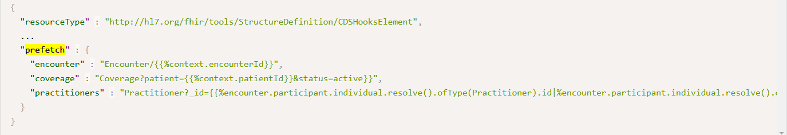
Prefetch discovery
Indicates (for a hook) what information the payer always needs
CRD Clients may or may not provide all requested prefetch information
Syntax is a list of queries to run
_include, _revinclude is not supported
Can contain simple embedded FHIRPath (x-fhir-query syntax) that refers to hook context and/or prior query results

Slide 53
What should be in prefetch?
Typically
patient, requester, location, encounter
Can include other information
Can vary by hook type
Can vary by type of request
Must
Be relevant almost always
Respect ‘minimum necessary’
Shouldn’t be the only mechanism the CRD service uses to get data

Slide 54
CRD Configuration
CRD servers may support many capabilities
Coverage information
Unsolicited prior auth
Covered therapy alternatives
Lower cost alternatives
In-network provider options
Duplicate therapy detection
Contraindication detection
Clinical guideline recommendations
Suggestions on missing tests
Some [organizations | departments | users ] may not want all of these
Some of these may also have configurable options
Degree of savings
Types of duplicate therapies to check
Etc.

Slide 55
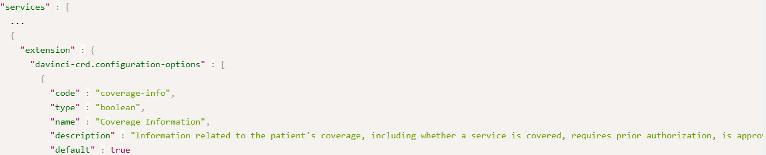
What is CRD Configuration?
List of options the CRD service supports that controls the responses it will provide + allowed values for those options
CRD clients specify the configuration options when they invoke a hook
At minimum must be able to toggle the different CRD card types and whether unsolicited prior authorization is desired

Slide 56
Example Discovery call
Request:
GET [base CRD URL]/cds-services
Response:
See here

Slide 57
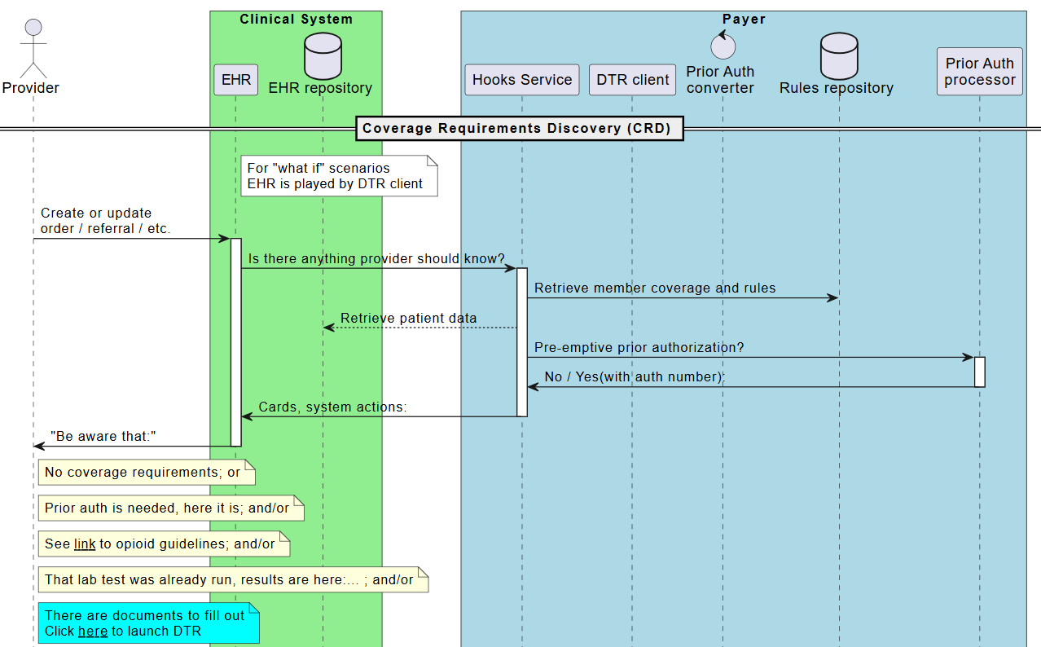
Workflow diagram

Slide 58
Hook invocation - client steps
What’s the probable primary coverage?
Which service should be called?
What prefetch data is needed?
For all orders in the hook invocation
What configuration settings apply?
for this type of order/department/user)

Slide 59
Primary coverage
CRD calls are limited to only ‘primary’ coverage
Provider won’t be choosing, so CRD client must make its best guess
If there are multiple requests
Pick the one that applies to most; or
Split requests into separate CRD calls
Once you know the coverage, you know the service
Once you know the service, you know the desired prefetch and configuration options

Slide 60
Performing prefetch
Prefetch is optional, but strongly encouraged
Clients can optimize data retrieval better than servers can
Every query + response adds delay and slows response to user
Usual query rules apply
Consent, data access permissions
A client can provide some prefetch information but not others
Empty prefetch element means “no data exists”
Missing prefetch element means “this prefetch not performed”
If a prefetch query is run, the whole thing must be run
Some prefetches can be run in parallel, others not
You don’t need to use a FHIR API to execute these

Slide 61
Configuration
Totally up to the CRD client how granular configuration should be managed
Can vary by
Department
User
Type of order
Which screen is used to order
Which hook is being used
‘Real’ vs. ‘What-if?’

Slide 62
CRD process for server
Did I get all the prefetches I asked for?
If not, query for the rest
Can I find this coverage/member?
What billing codes are possible?
What additional information should be retrieved?
For each billing code
Is it covered? More info needed? Prior auth needed? Prior auth granted?
Are there other useful things to share?
Create response

Slide 63
Ancillary data
Link to resources retrieved by prefetch

Slide 64
Querying data
May need to query CRD client because
Not all prefetches returned
Additional data is needed based on the request(s)
Check the CapabilityStatement of the server to see what query features are supported
_include, etc. may be possible
Query using batch may also be possible
Experiment whether this is more/less performant than individual parallel queries
Can query for prefetch and additional data simultaneously
Can query as requirements are identified

Slide 65
What if key information is missing?
If the base prefetch data required by CRD is
Not included as prefetch data in the hook invocation
Not available when performing a search
I.e. can’t search for it, rather than “no data exists”
Return a 412
If there’s additional data you need to
Verify coverage
Determine authorization requirements
Grant prior auth
Return coverage information as best you can. DO NOT error

Slide 66
If you can’t find the coverage
If
The member or coverage isn’t recognized
The coverage doesn’t apply to the service
The coverage is expired
Do not error
Return a coverage-information indicating “not covered” and explain why in the reason

Slide 67
What billing codes are possible?
The code used when ordering/booking an appointment/etc. will not necessarily be the code on the claim
This is true even if the ordered code is a CPT code
Payers will need to figure out what possible billing codes are ‘reasonably likely’ for a given order
If there are a small enough number, evaluate coverage requirements for all
If coverage requirements vary, return a separate coverage-information extension for each ‘set’ with different rules
If there are too many to reasonably evaluate
Return coverage-information saying “detailed-code” is needed

Slide 68
Billing code considerations
If there are multiple possible billing codes
Can’t return unsolicited prior authorization
Mapping order codes to billing codes is complex
See the presentation at the Da Vinci education event

Slide 69
Returning a response
Two types of responses:
System-action
Automatically creates or updates an existing record
Used for
If updating, use the

Slide 70
What about delegates?

Slide 71
Data retrieval
Returning cards
Returning system actions
Subsequent hooks
What-If Invocation
EHR can perform what-if locally, or launch a SMART app
Must indicate that no prior auth is wanted
CRD Hooks
CRD Responses
Coverage Information extension
CRD security expectations
Data is exchanged over TLS (as per Hrex)
CDS Clients decide whether to invoke CRD services and what the payer can see
CRD service queries need to adhere to minimum necessary
Data received is limited to providing decision support, audit, and tracking issued authorizations
Data is limited to scopes server needs and client is willing to offer
Token expiration should be 30 seconds or less
Other expectations
5 seconds (10 seconds if no prior hook for the patient in the last 24 hours)
Results longer than this may be ignored
CRD clients aren’t required to block
Results must be reliable
Logical model for measures

Slide 72
Outline
SDC on DTR Outline
SDC in DTR
Core Expectations
Supporting Elements
Special Elements
CQL in Questionnaires
Architecture Considerations

Slide 73
Summing Up

Slide 74
Course Objectives
After completing this course, you should be able to:
List the sections from SDC used by DTR
Describe the trade-offs between adaptive and standard forms
Explain some of the considerations for using CQL with DTR forms
Design questionnaires that account for the must support and optional elements in the SDC Questionnaire profiles
Summarize the key rendering and behavioral options available for use for DTR

Slide 75



Questions/Discussion
lloyd@dogwoodhealthconsulting.com
Or, better yet, include the community and ask/discuss on https://chat.fhir.org/#narrow/channel/197320-Da-Vinci-DTR or
https://chat.fhir.org/#narrow/channel/179255-questionnaire

